Slide 1
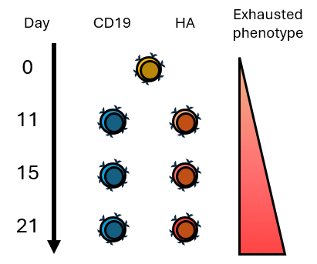
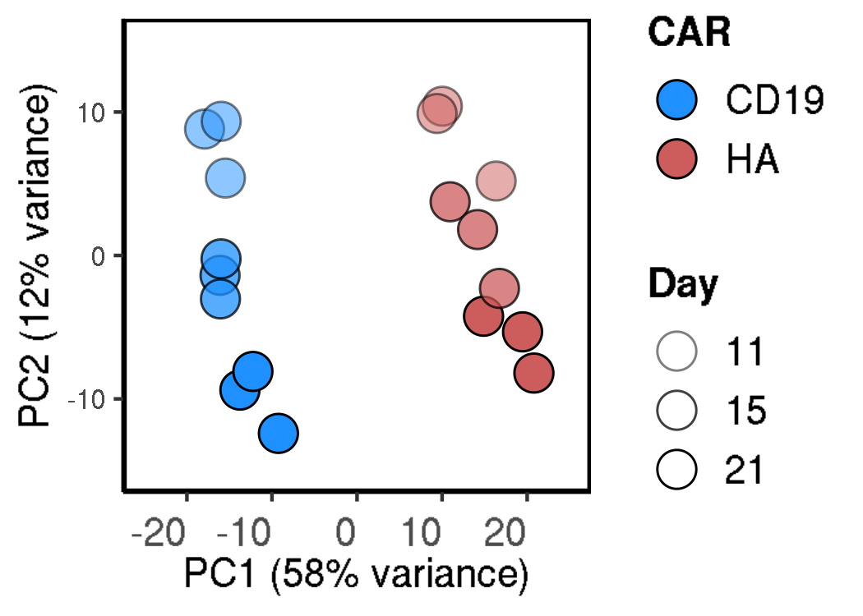
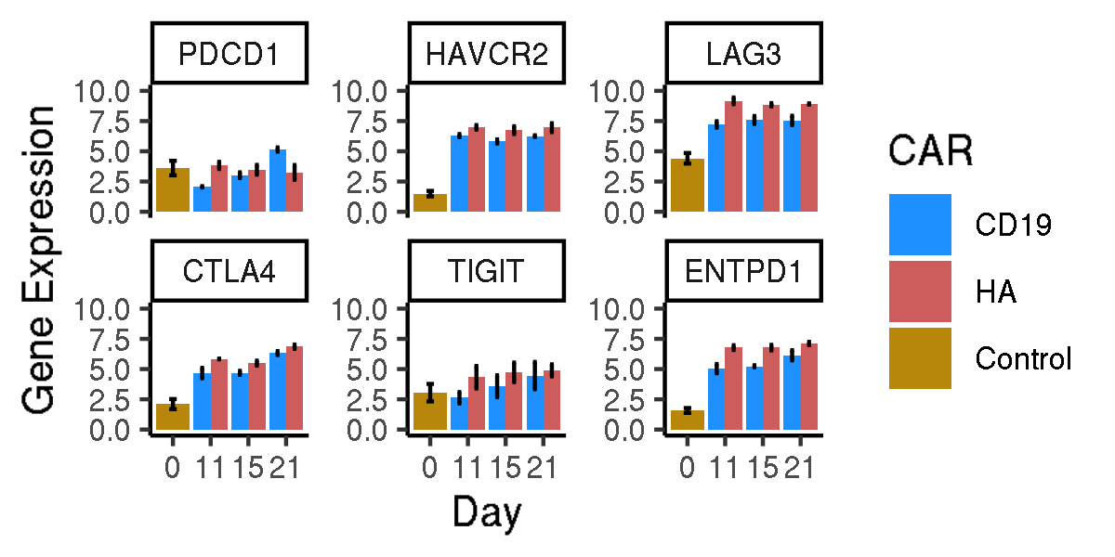
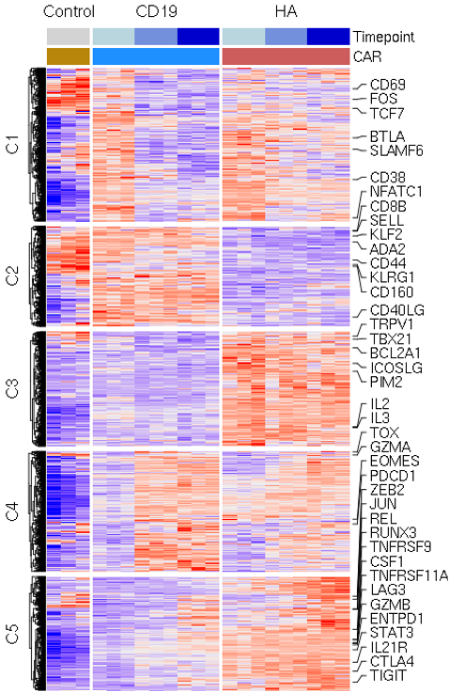
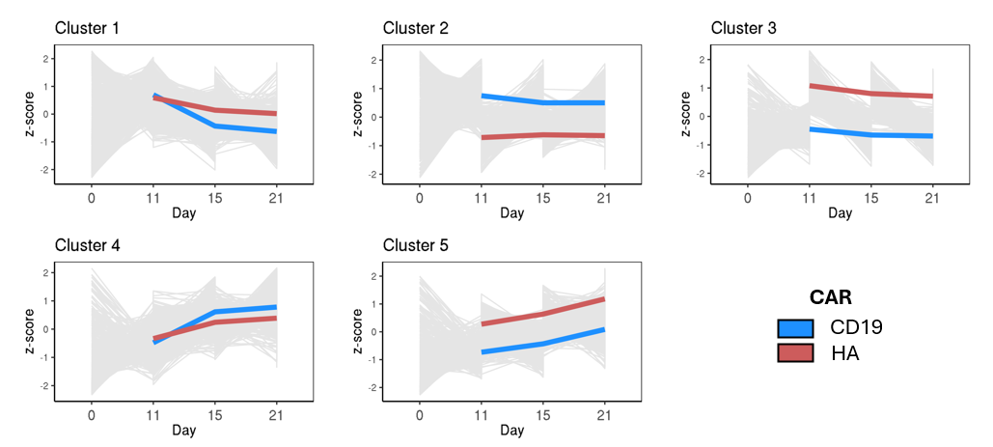
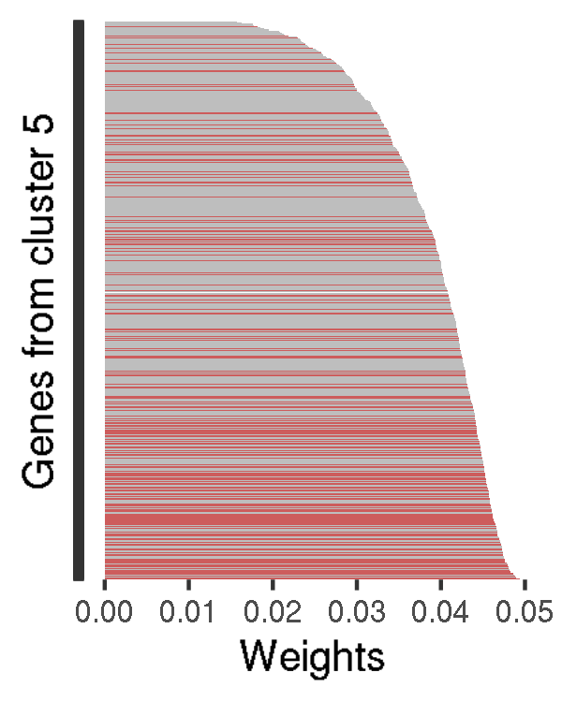
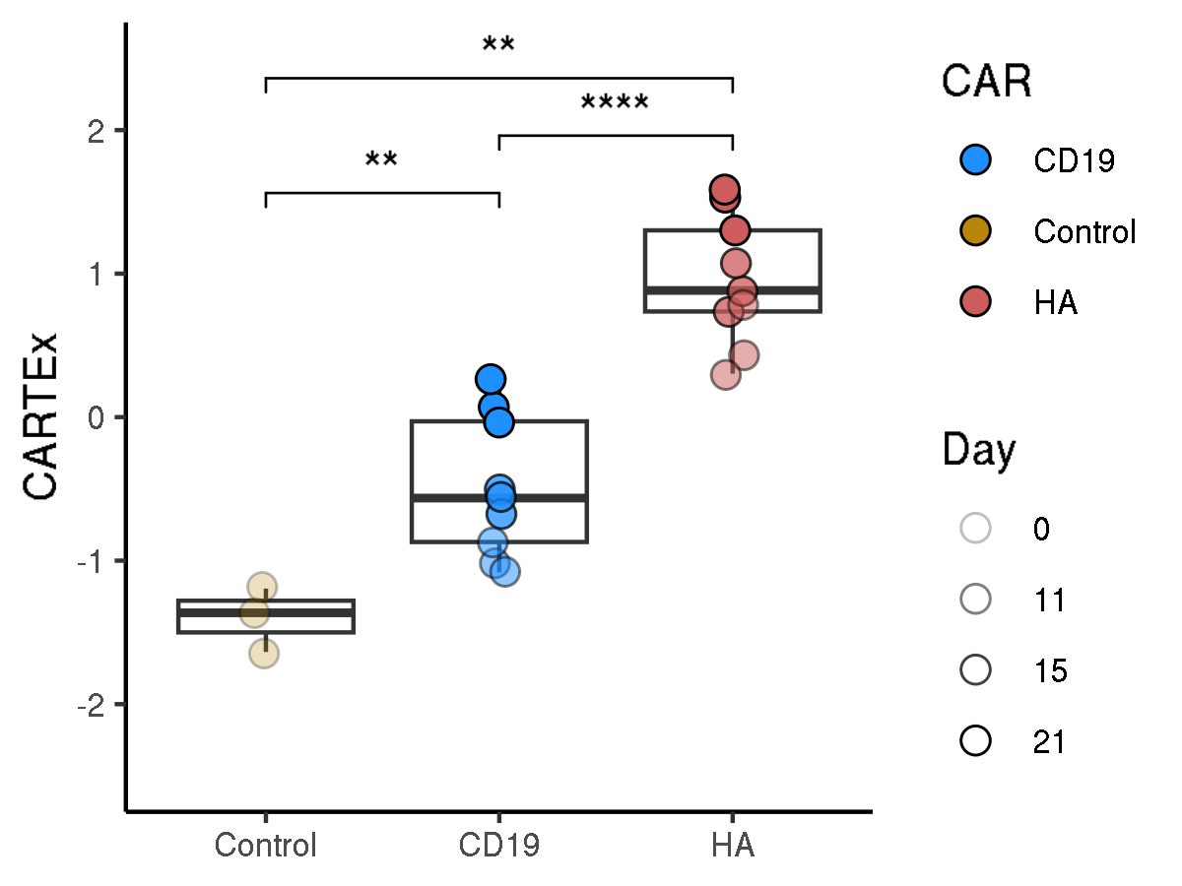
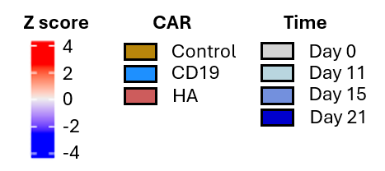
CARTEx project
Figure 1. Bulk RNA sequencing of functional and exhausted CAR T cells across 21 days
A
B
C
D
E
F
G

Slide 2
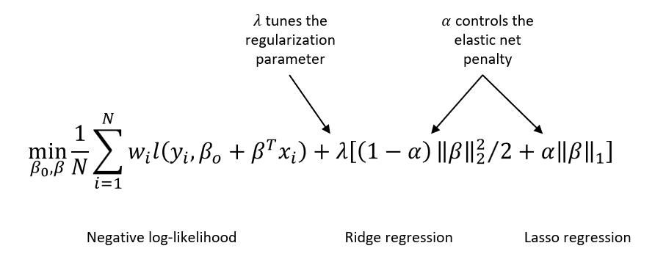
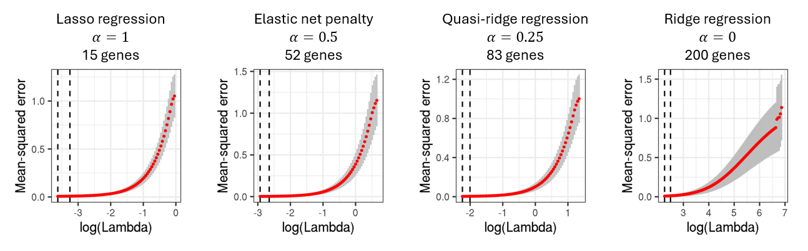
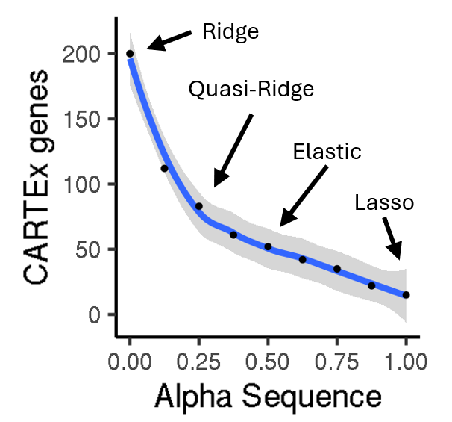
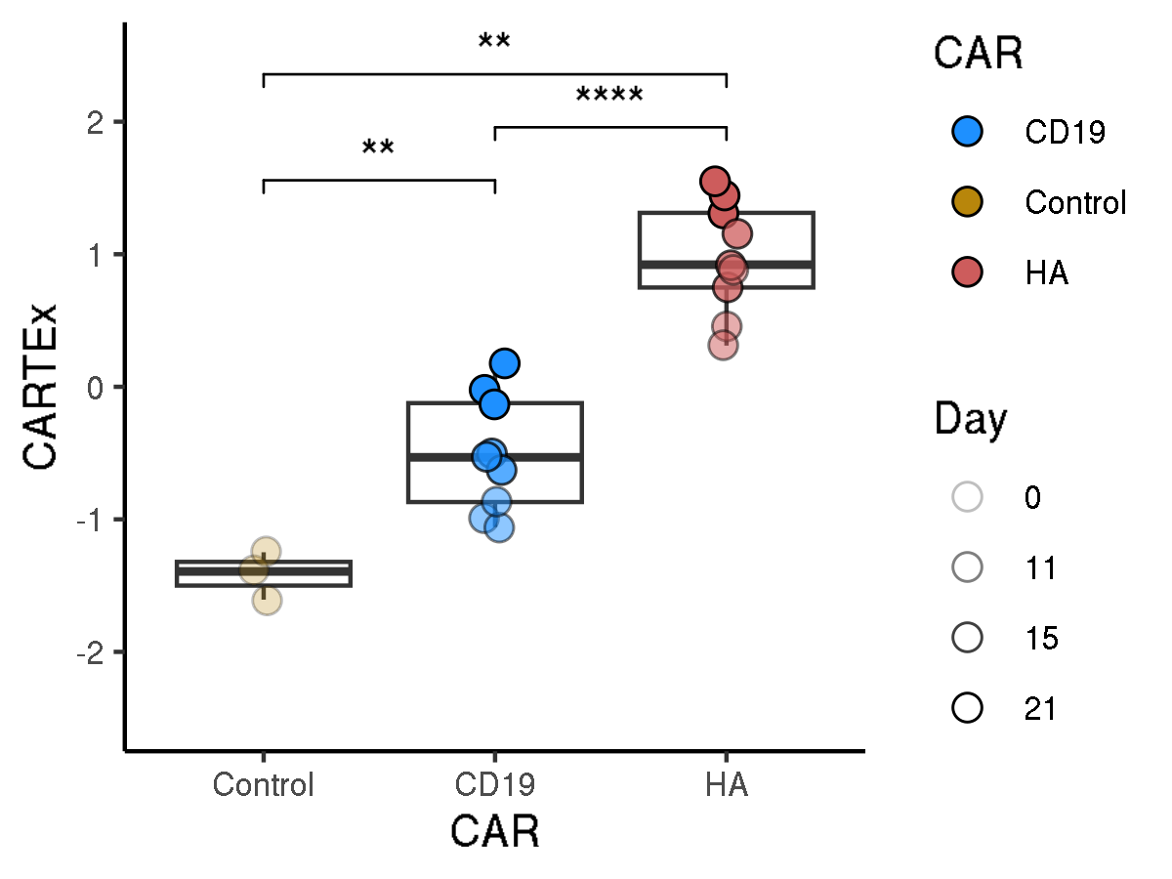
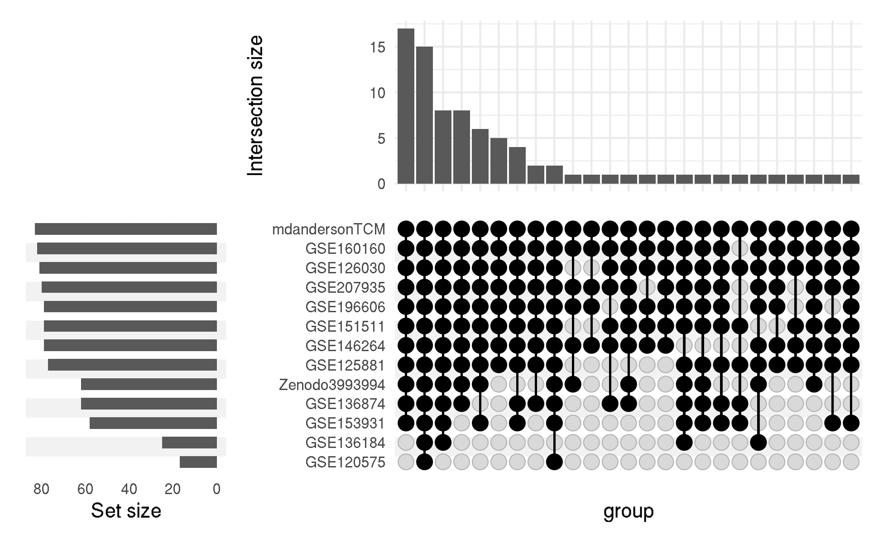
CARTEx project
Supplementary Figure 1. glmnet
A
B
C
D
E

Slide 3
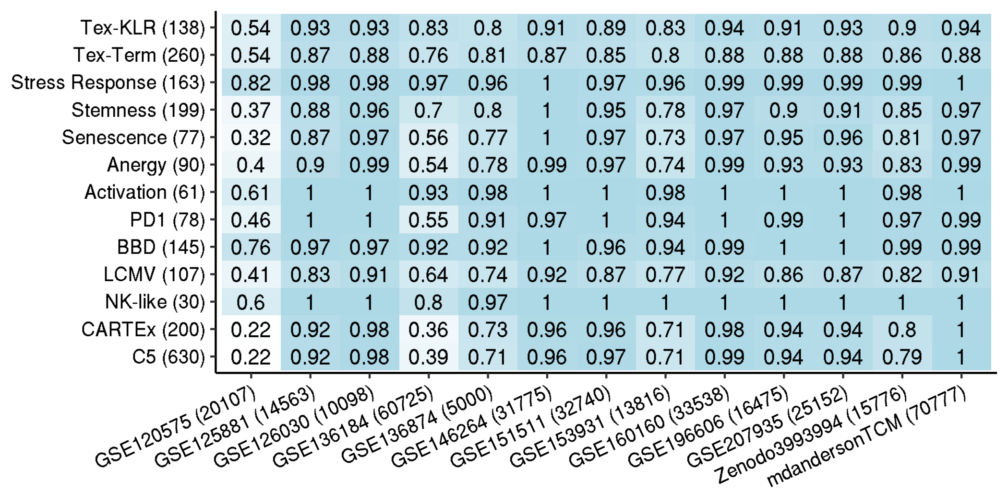
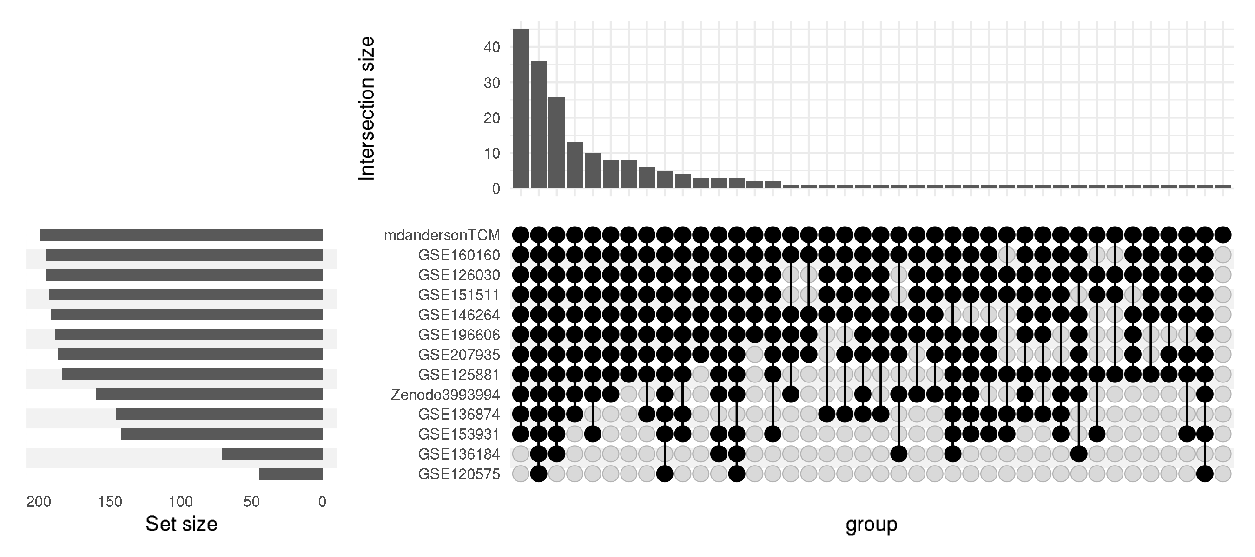
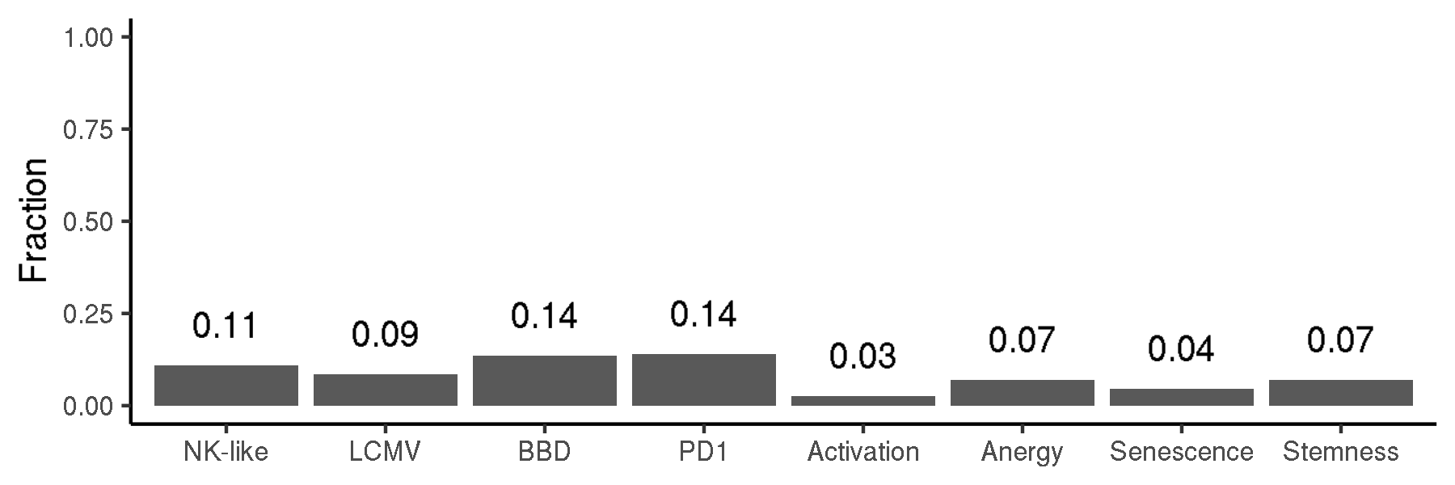
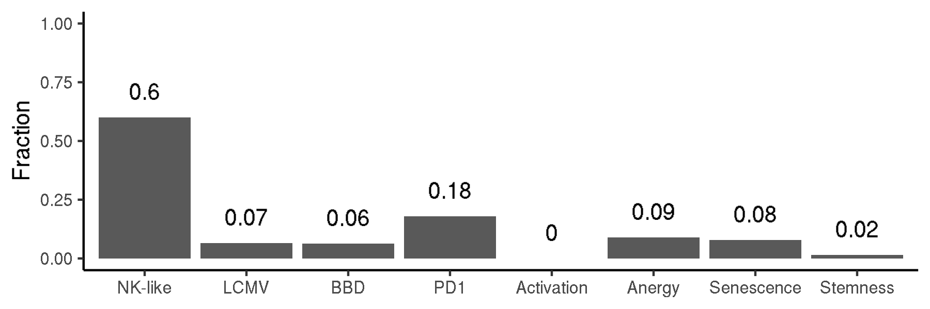
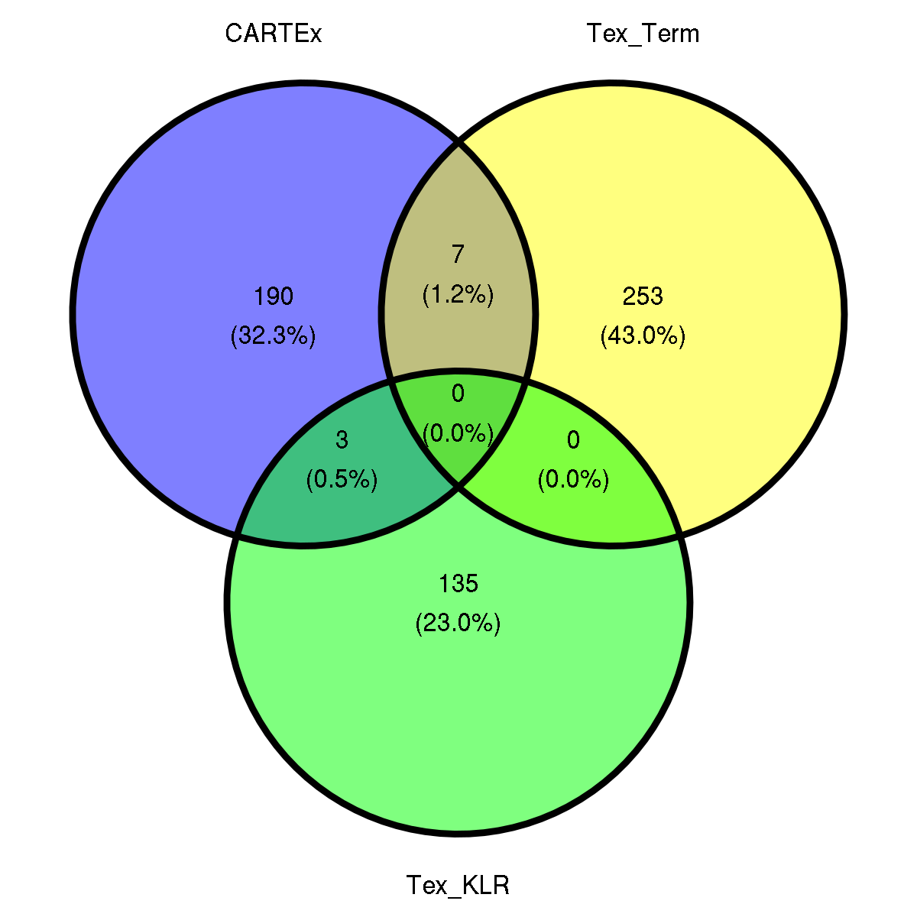
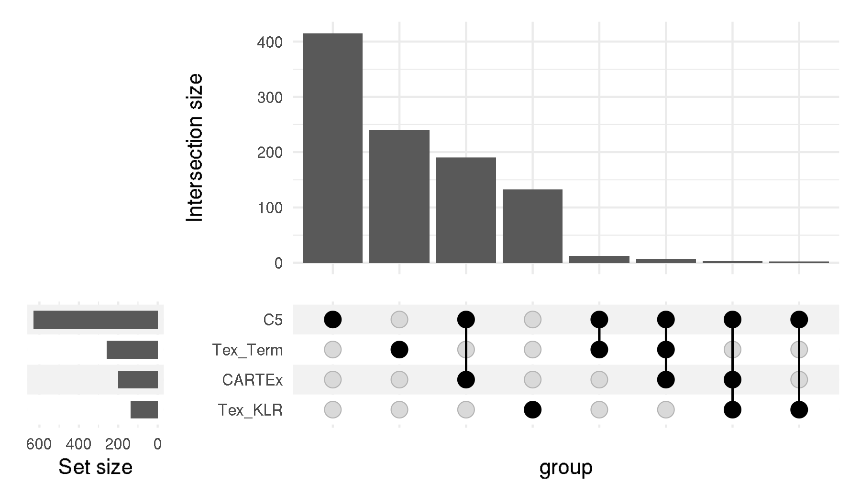
CARTEx project
Supplementary Figure 2. Signature representation
A
B
C
D

Slide 4
CARTEx project
Supplementary Figure 2.
E

Slide 5
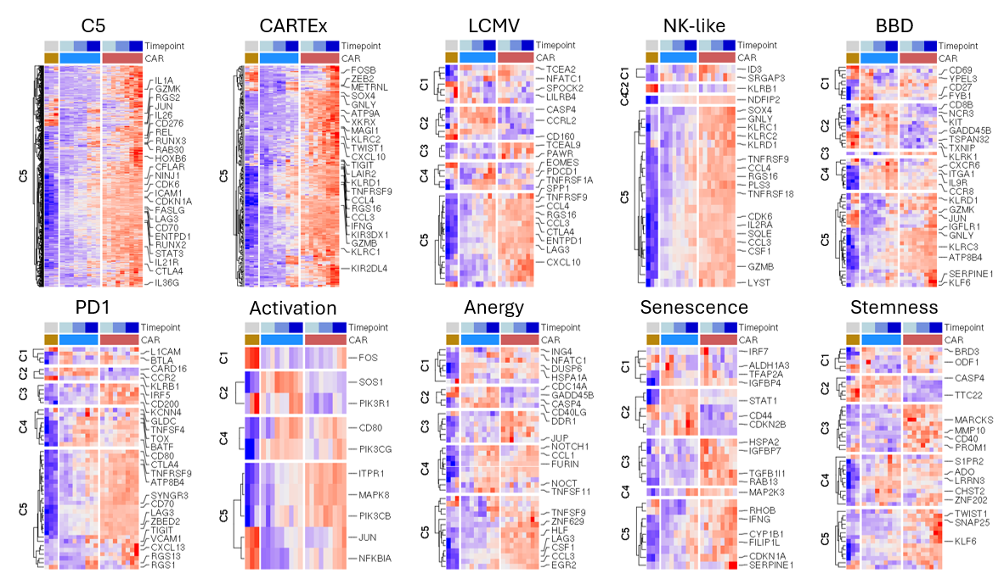
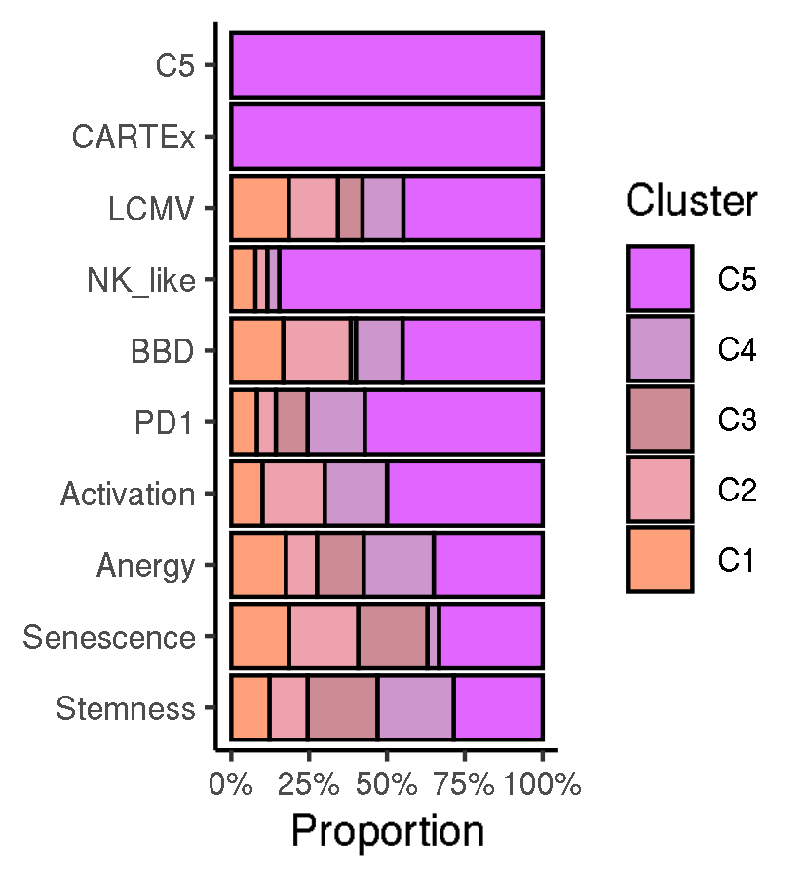
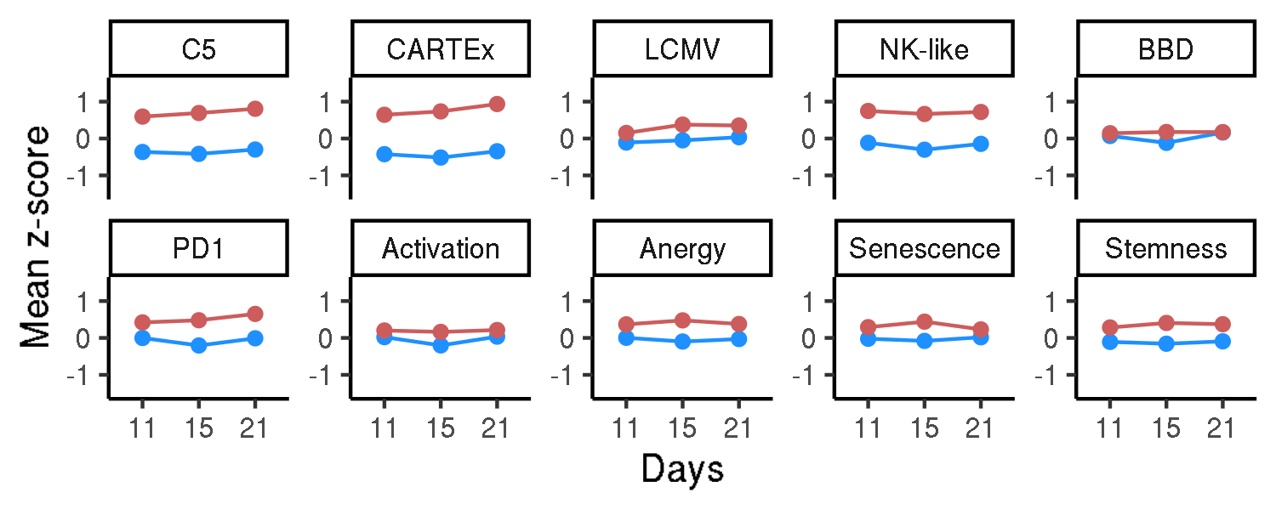
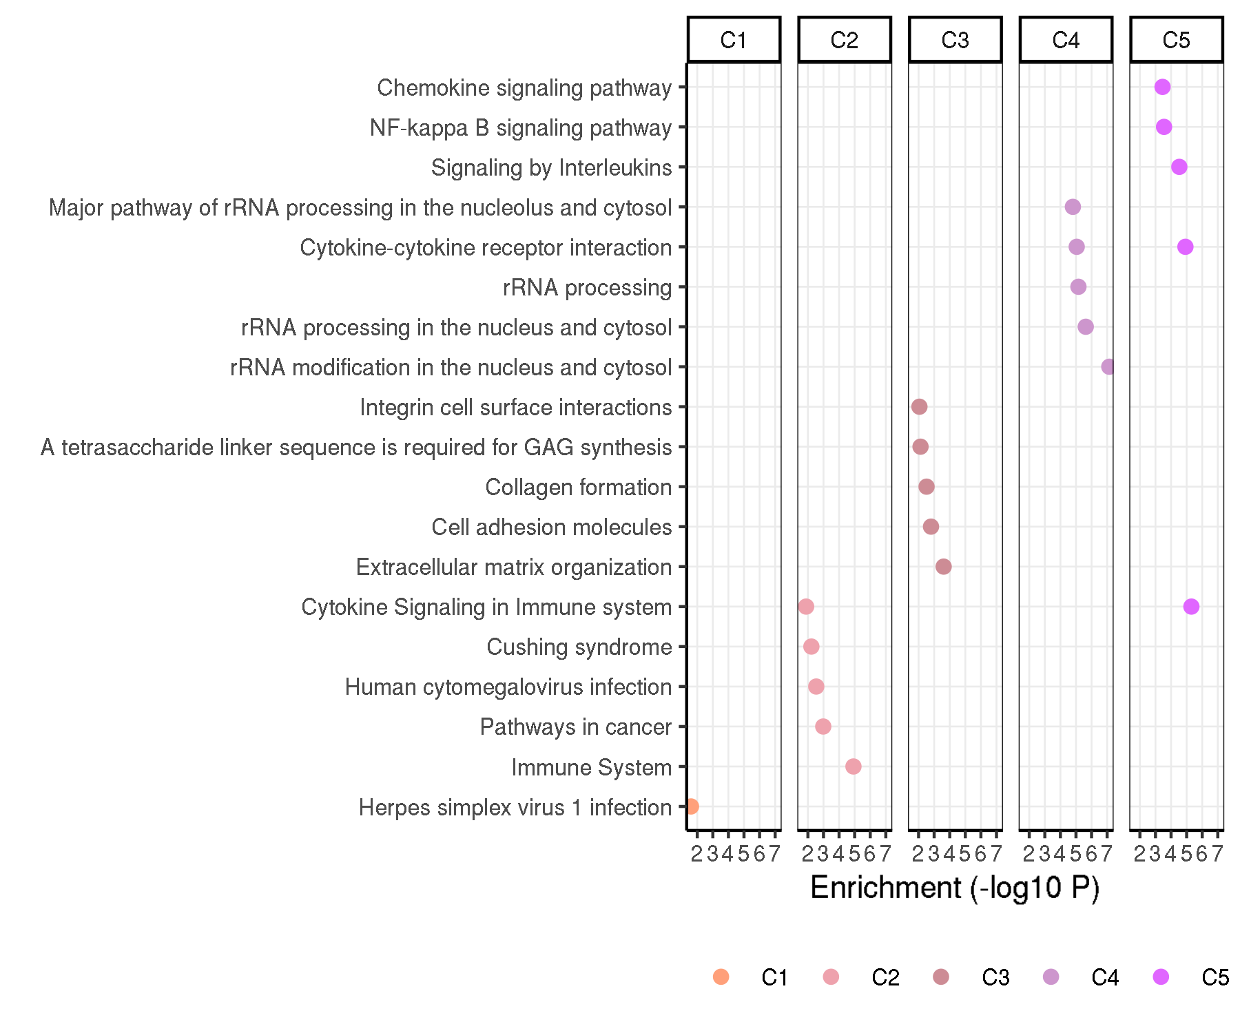
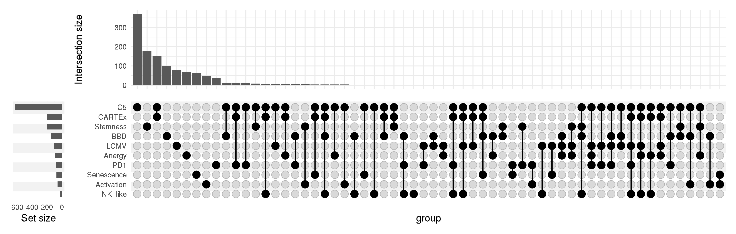
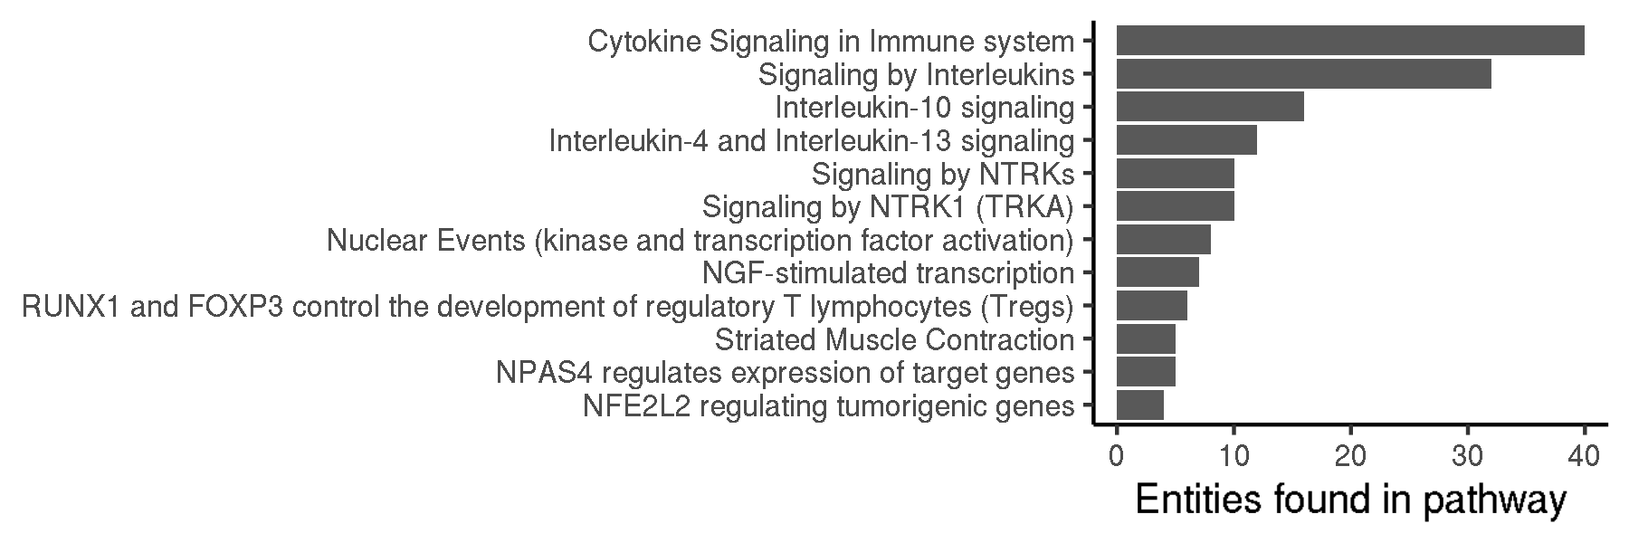
CARTEx project
Figure 2. Biological context / Evaluation with other exhaustion and cell state signatures
A
B
C
E
D
F

Slide 6
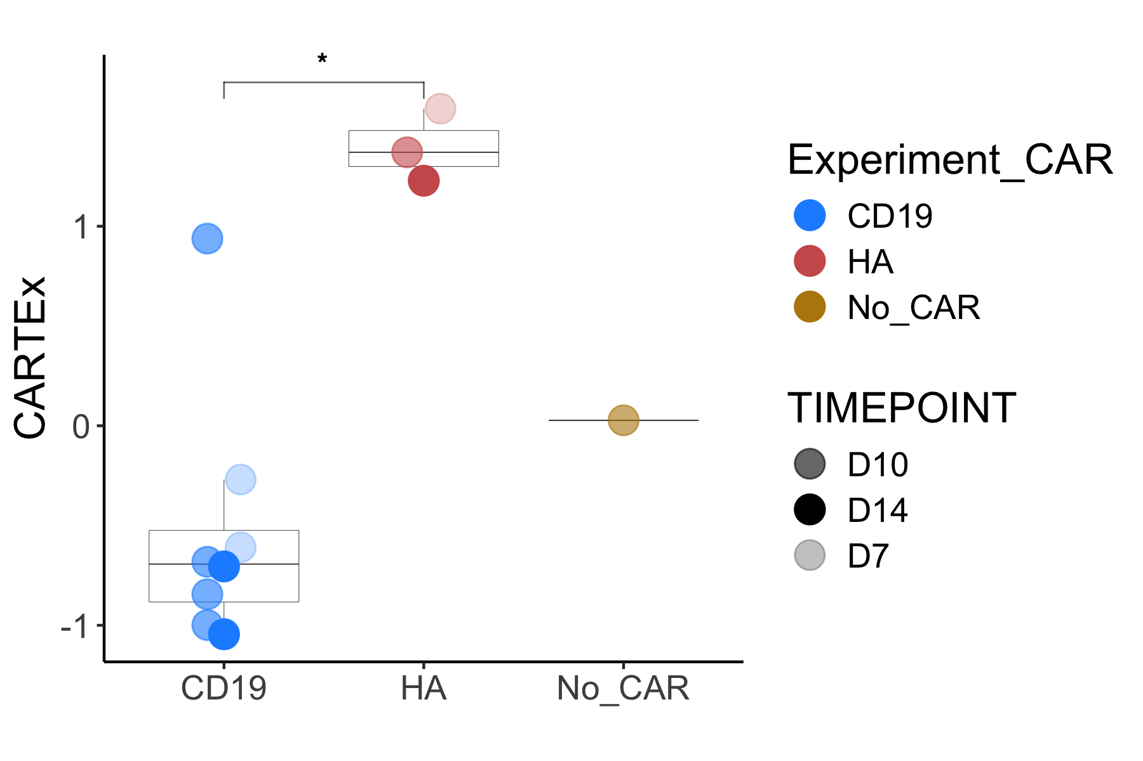
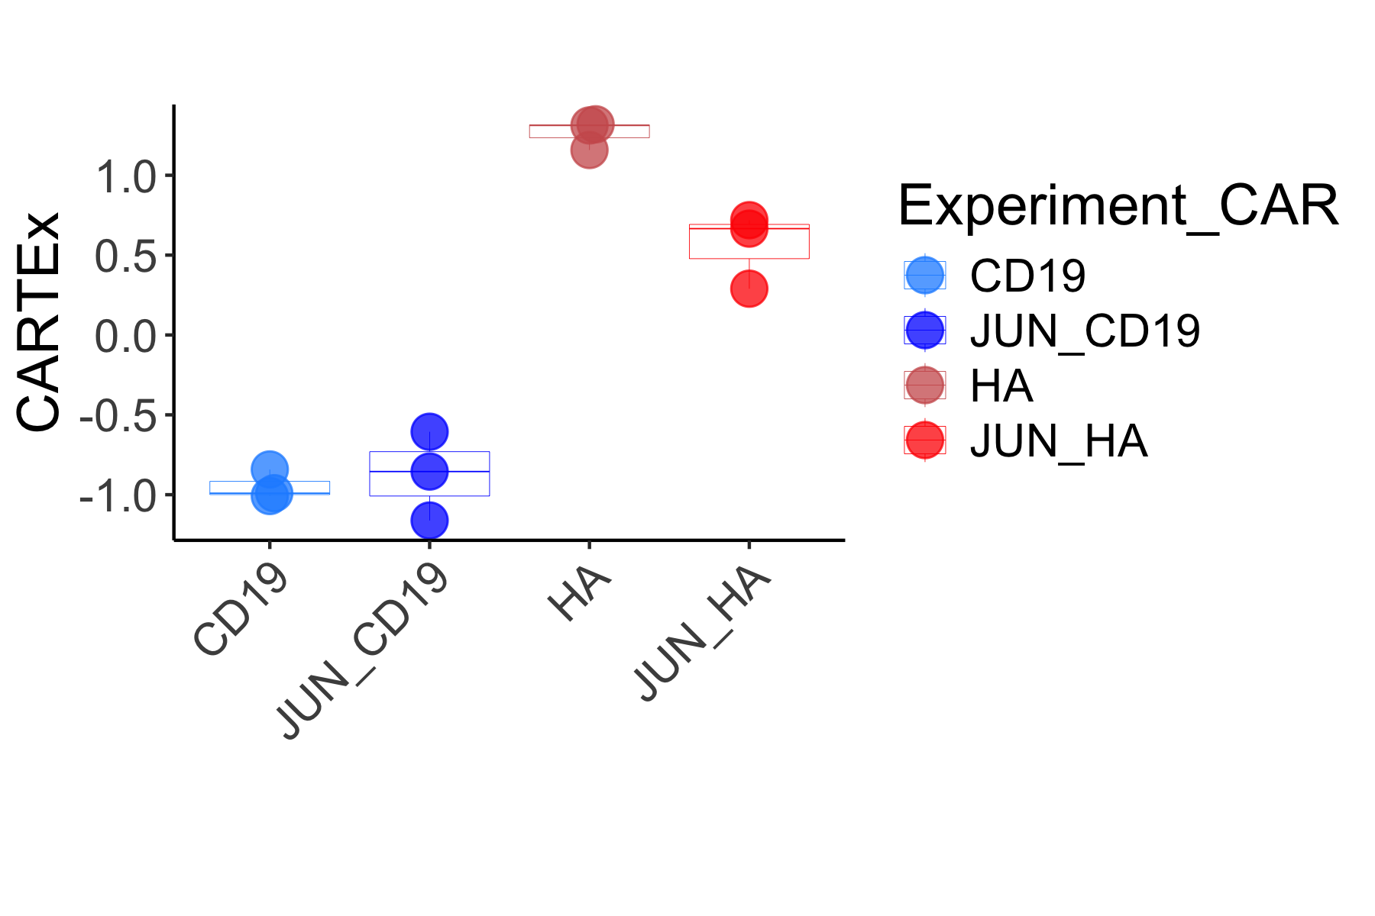
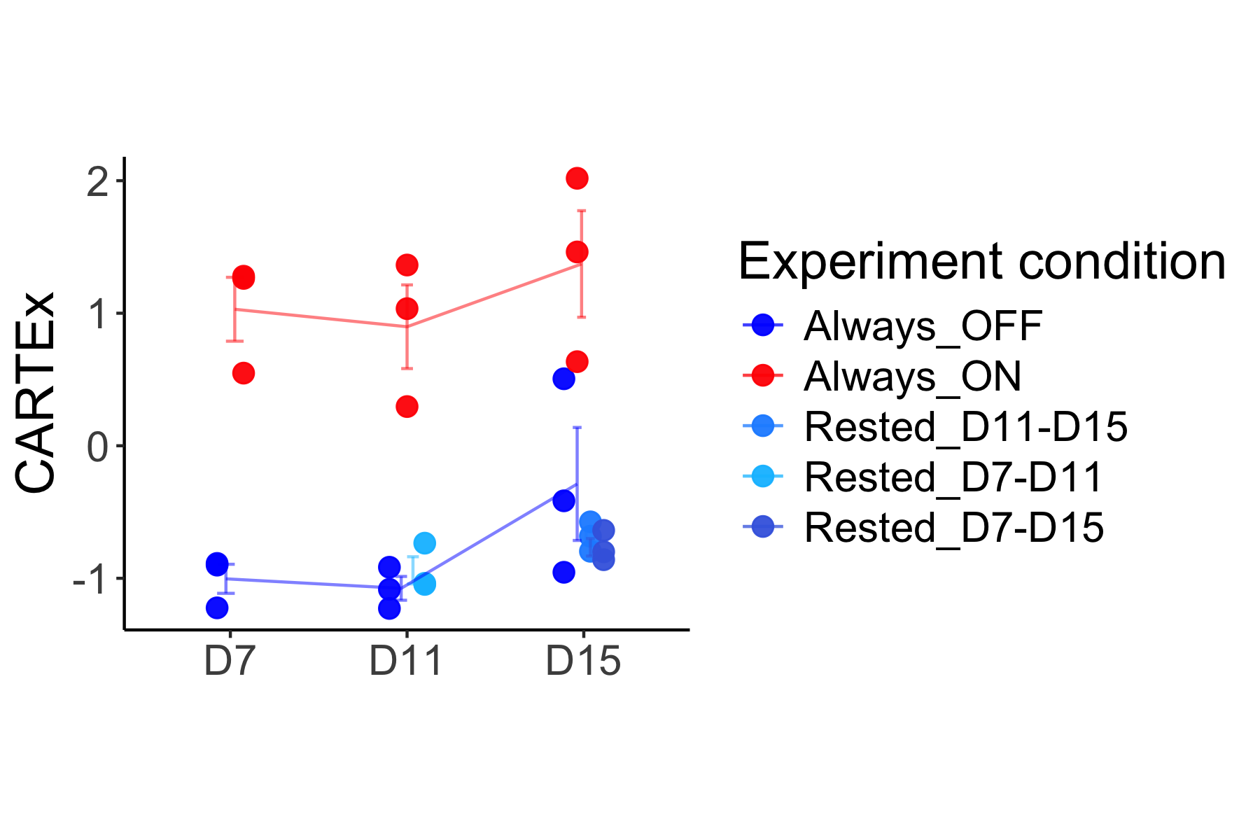
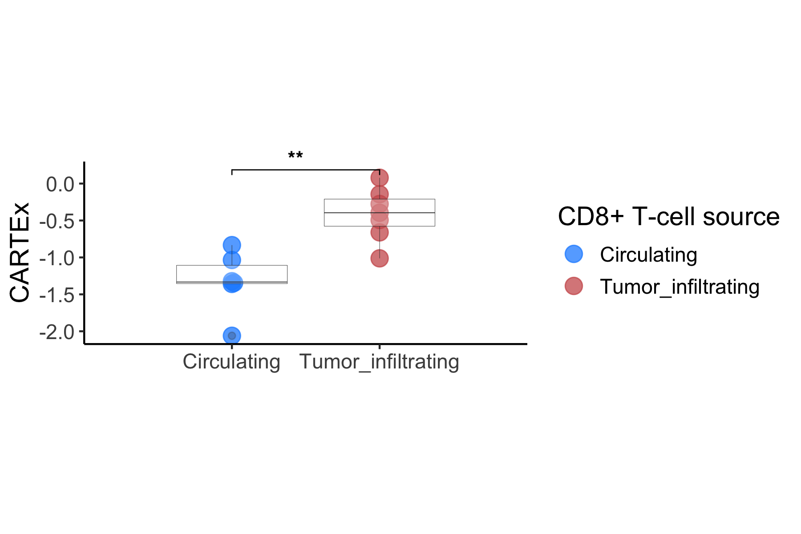
CARTEx project
Supplementary Figure 3. Applying CARTEx signature to bulk RNA sequencing data
A
B
C
D

Slide 7
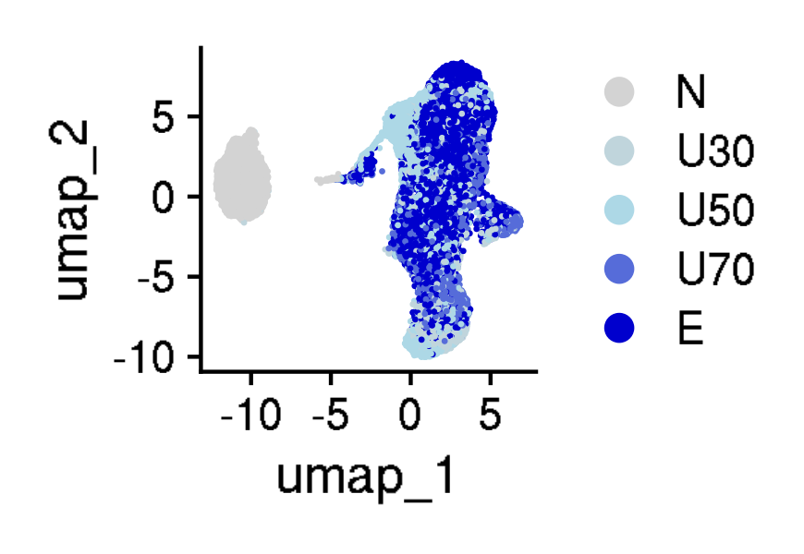
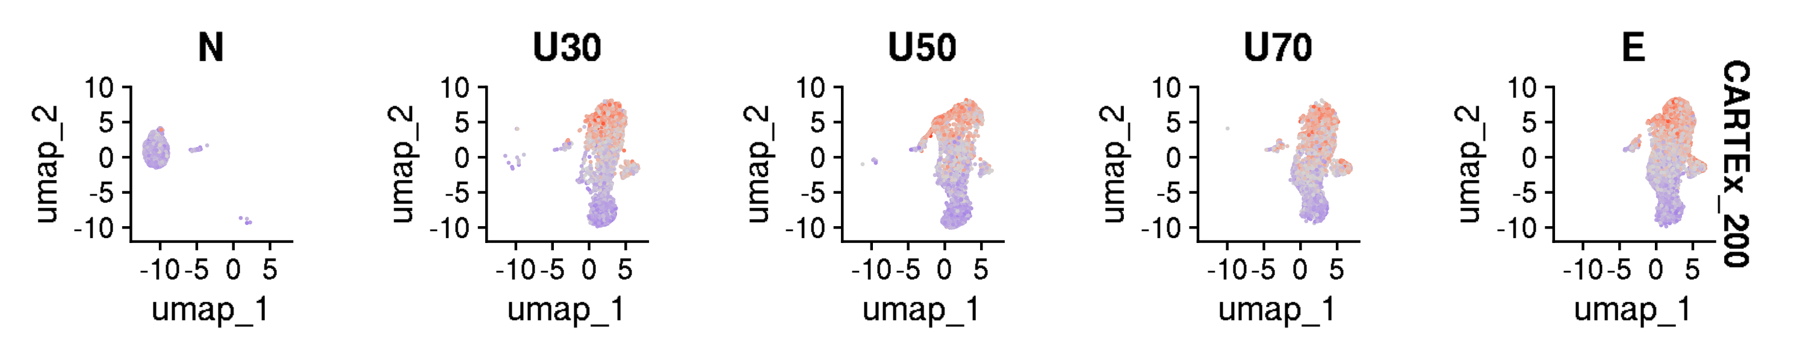
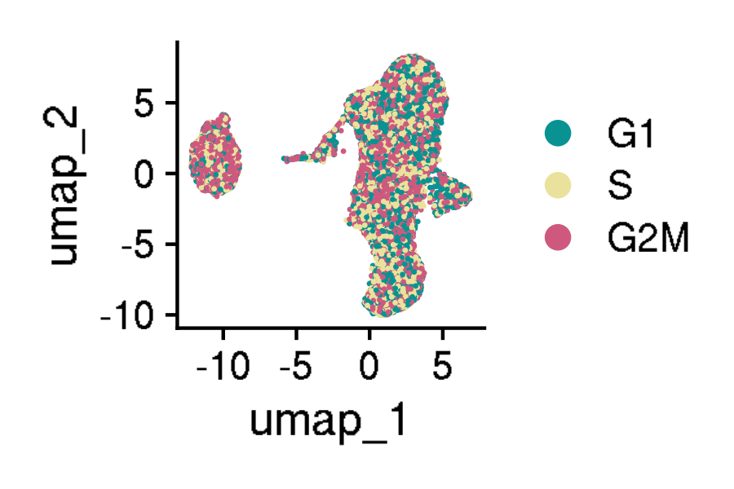
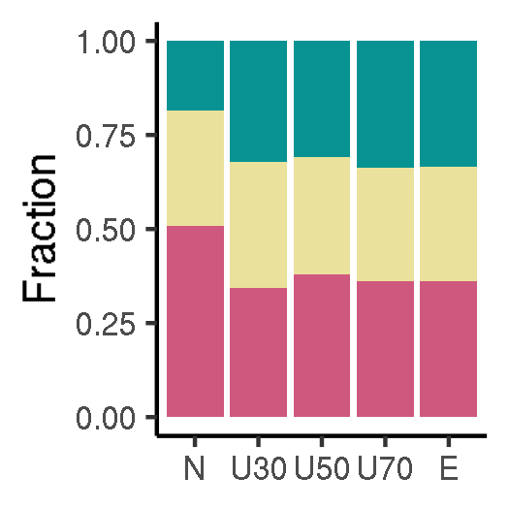
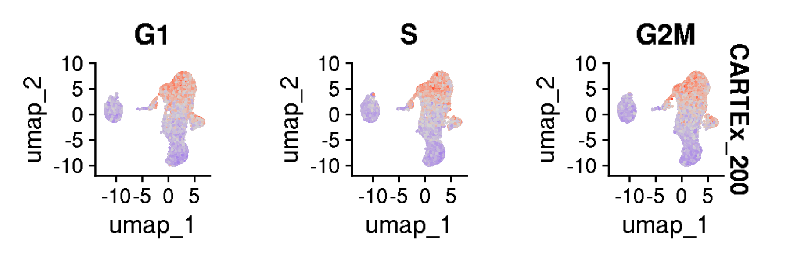
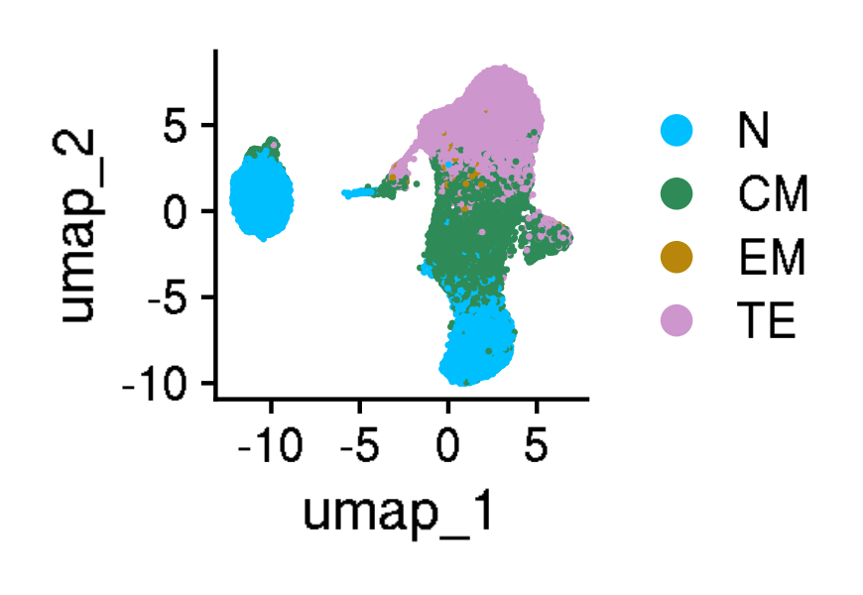
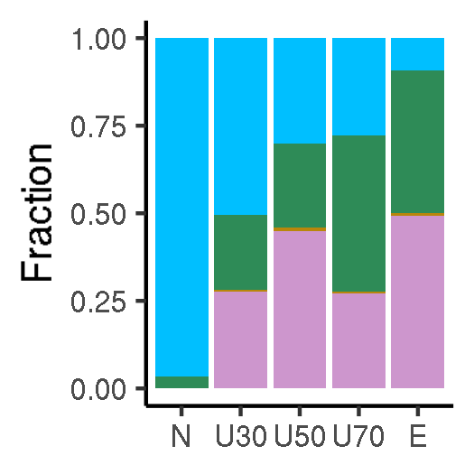
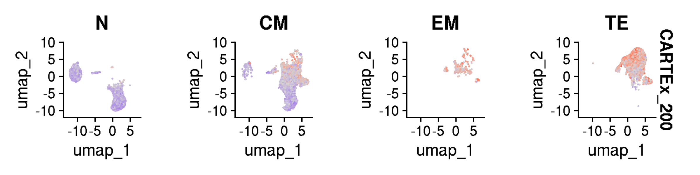
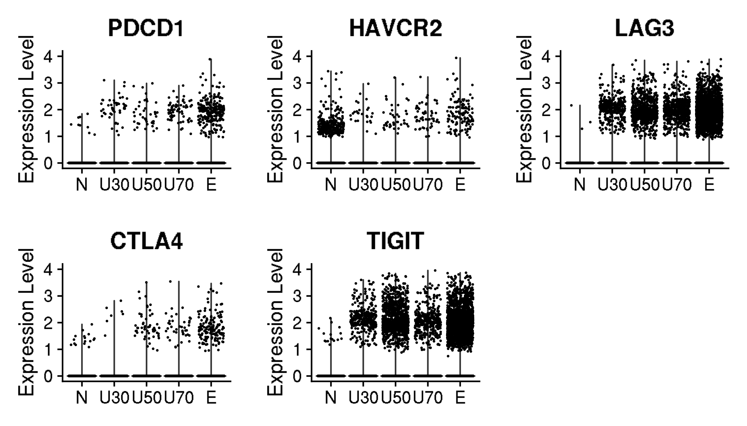
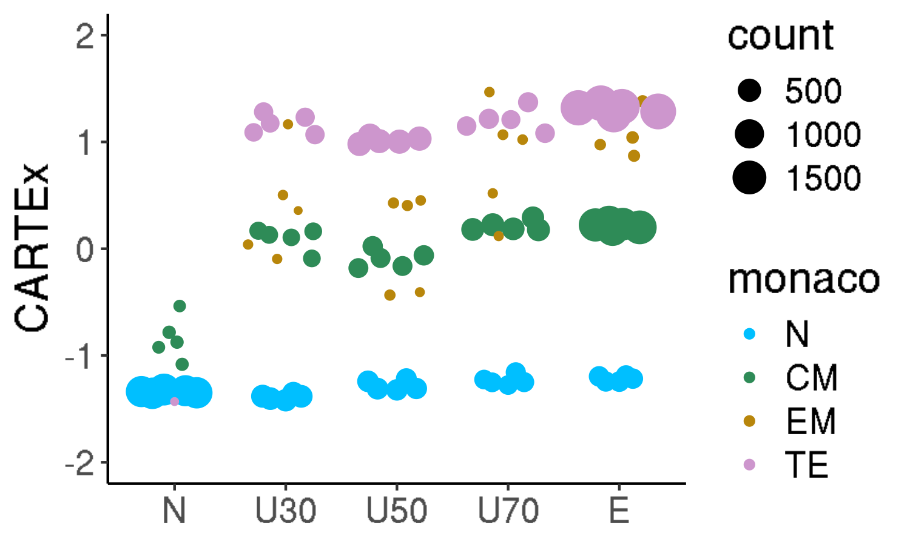
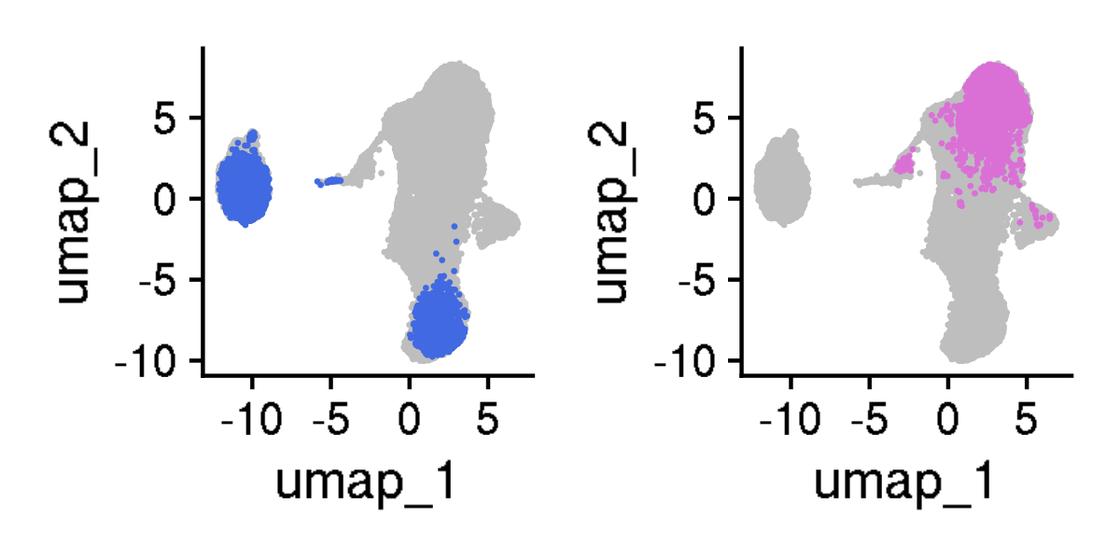
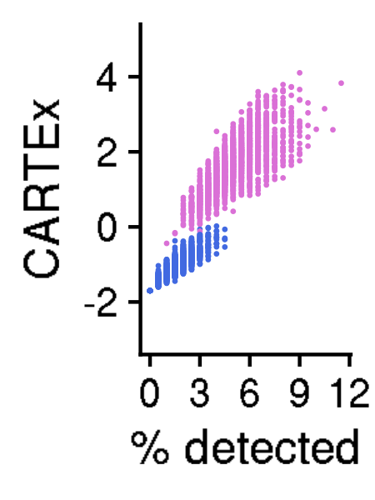
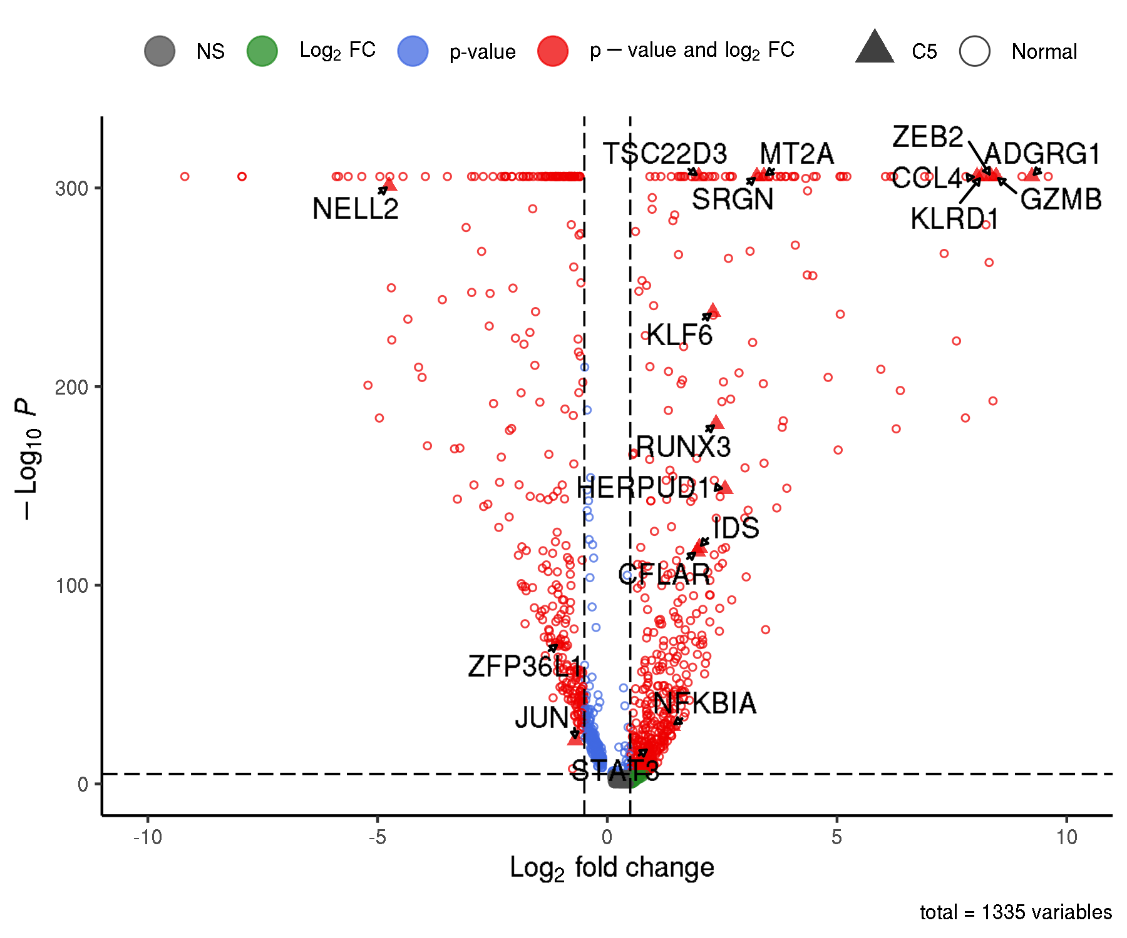
CARTEx project
Figure 4. T cell exhaustion is distinct from aging, cell cycle, and differentiation
A
B
C
D
E
F
G
H

Slide 8
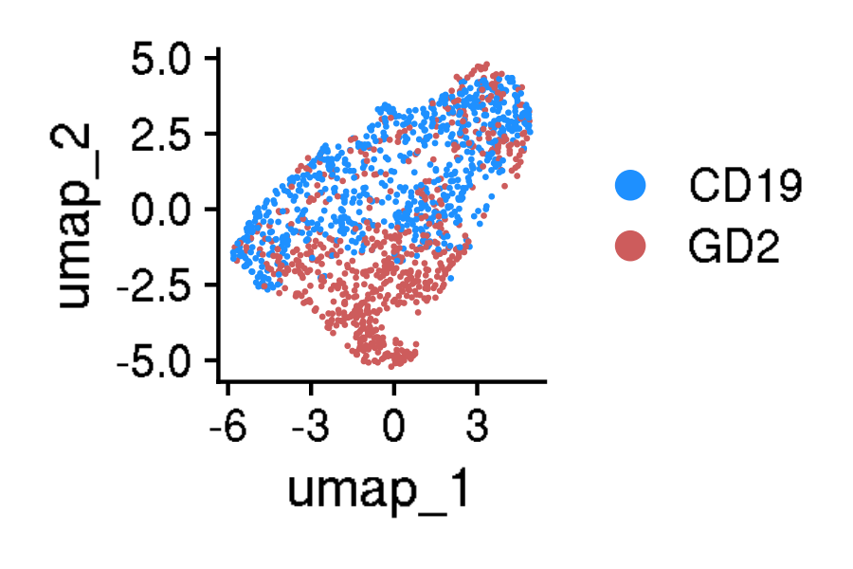
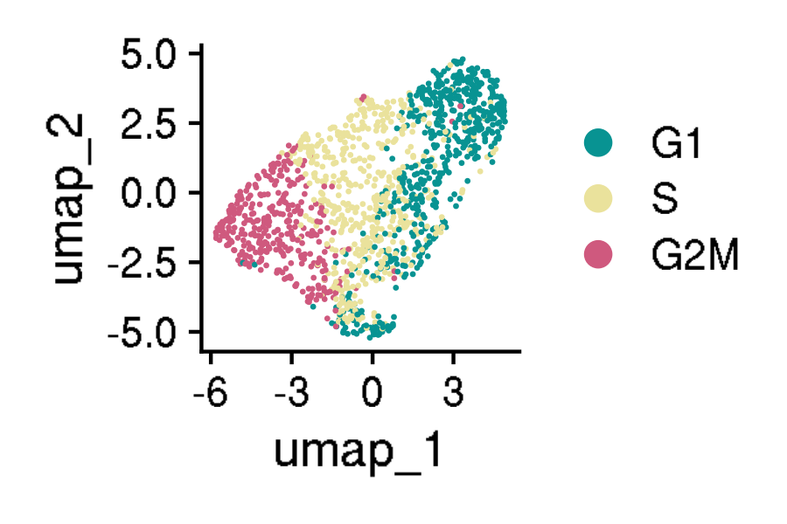
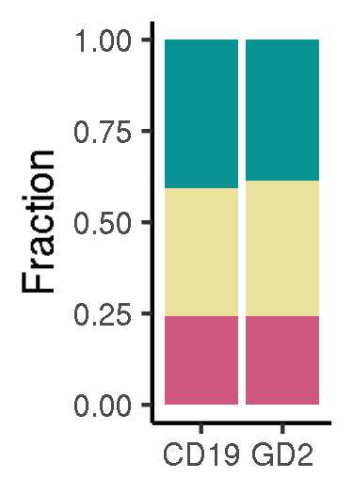
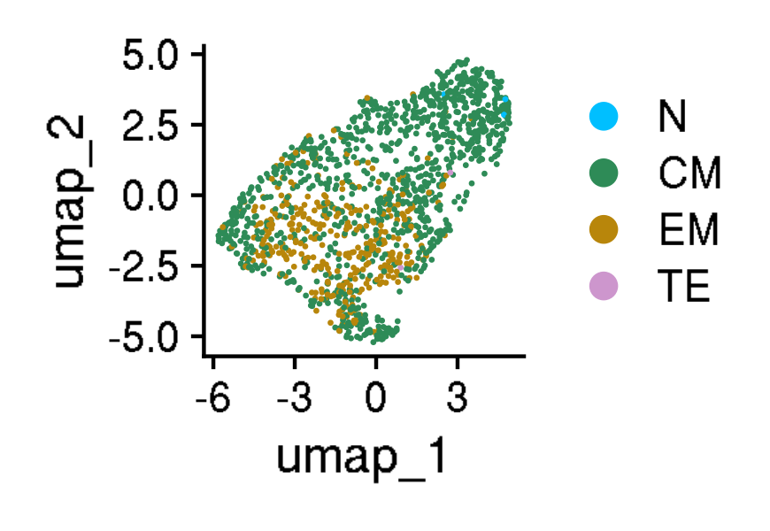
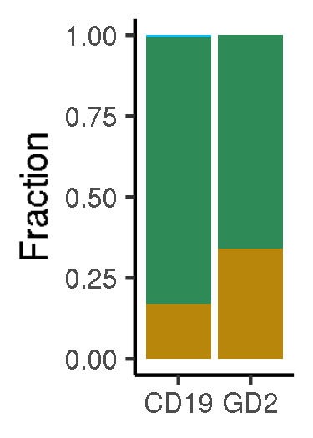
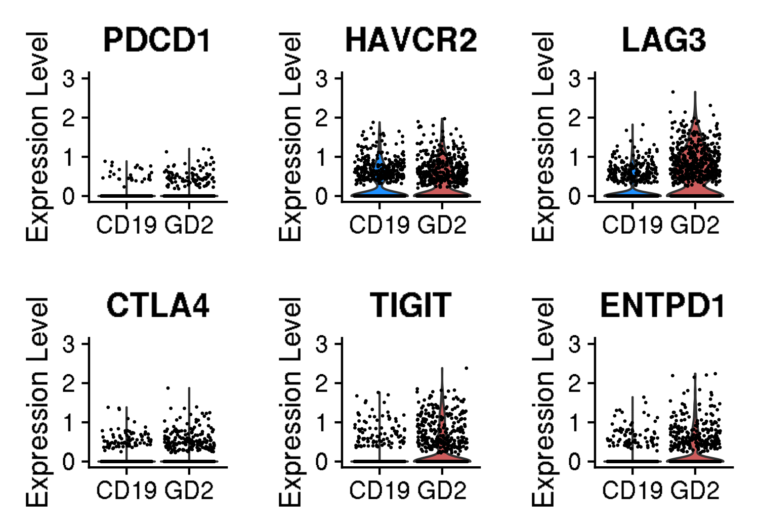
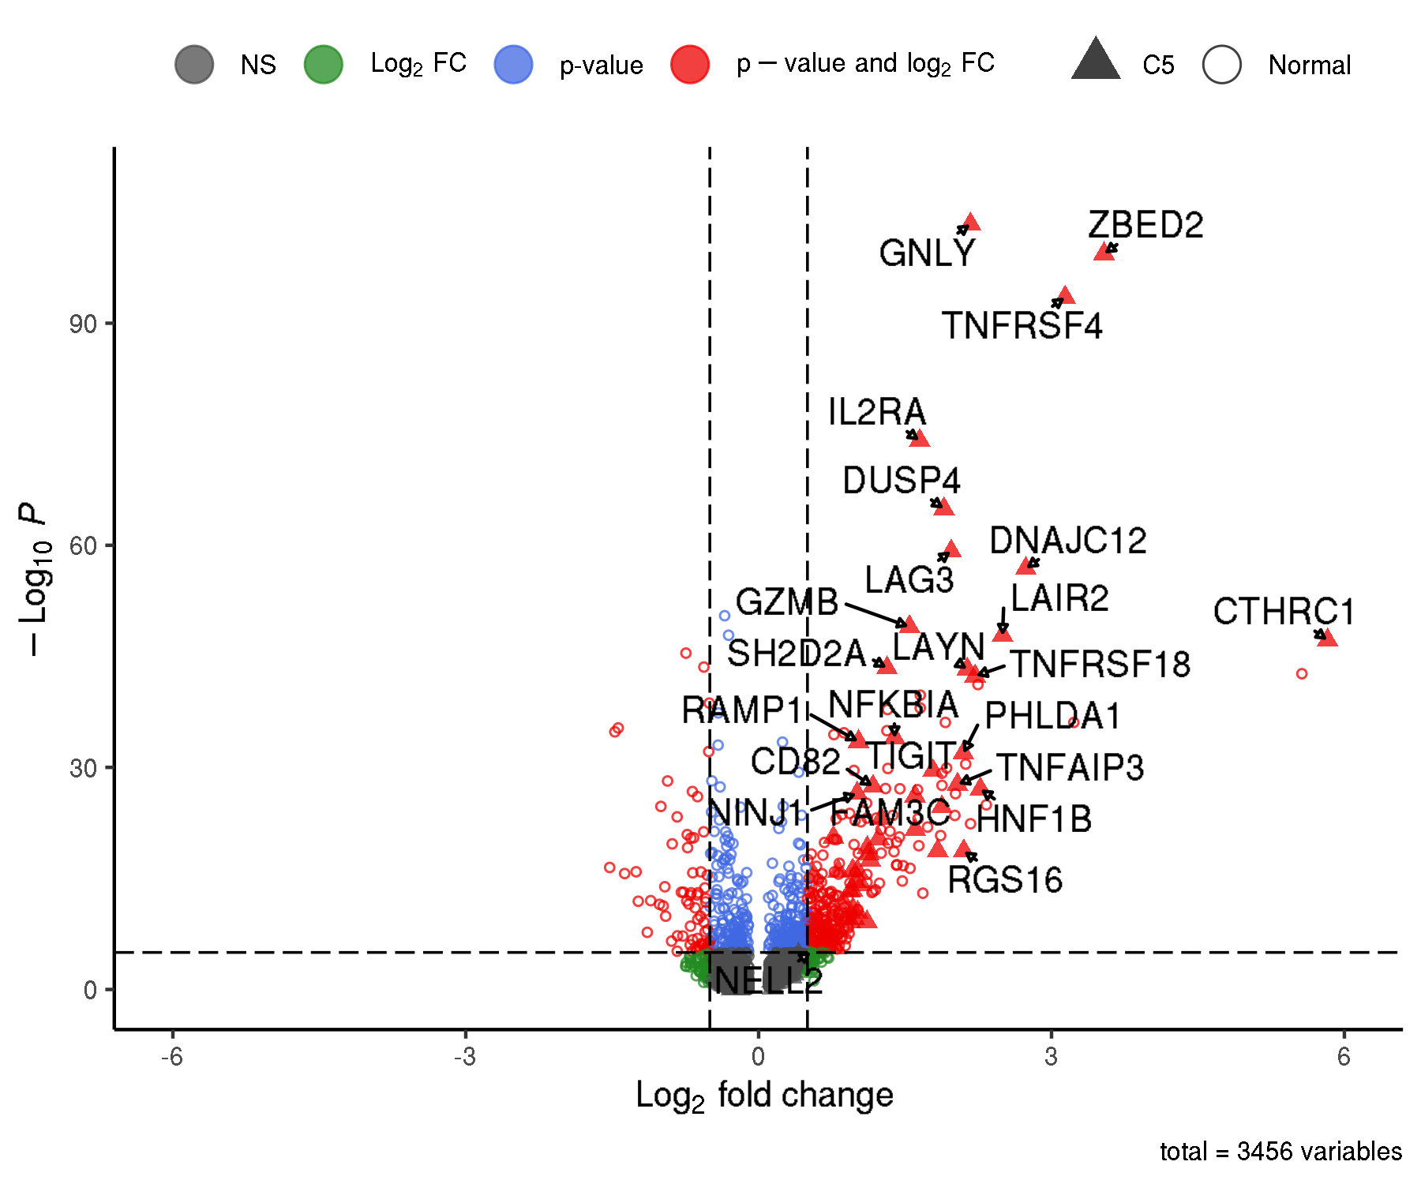
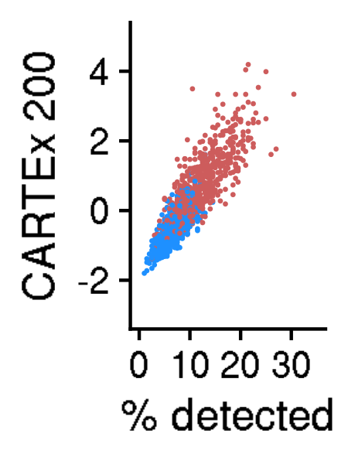




















CARTEx project
Figure 5. Validation in exhaustion-prone models
A
B
C
D
E

Slide 9
























CARTEx project
Supplementary Figures for validation in exhaustion-prone models

Slide 10














CARTEx project
Supplementary figures. Activation and resting T cells from healthy donors

Slide 11













CARTEx project
Supplementary figures. T cells from healthy donors and cancer patients (MD Anderson pan-cancer)

Slide 12





























CARTEx project
Figure 6. CARTEx applied to clinical oncology

Slide 13













CARTEx project
Supplementary Figure. COVID-19 severity and SARS-CoV-2-reactive T cell exhaustion

Slide 14












CARTEx project
Figure 7. CARTEx applied to CD8 T cells in autoimmune disorders

Slide 15













CARTEx project
Supplementary Figure. More STAT3 GOF

Slide 16







CARTEx project
Supplementary Figure. More STAT3 GOF (cell type differentiation)

Slide 17














CARTEx project
Supplementary Figure. More STAT3 GOF (diffusion maps)

Slide 18










CARTEx project
Supplementary Figure. Severe psoriasis is distinct from T cell exhaustion

Slide 19











CARTEx project
Supplementary Figure. BEACH domain deficiencies (autoimmunity caused by defective CTLA-4 trafficking)

Slide 20















CARTEx project
Supplementary Figure. T cell exhaustion in neurodegenerative diseases

Slide 21
CARTEx project
EXTRA SLIDES

Slide 22








CARTEx project
Supplementary Figures for aging dataset (this is longitudinal data)
A
B
A

Slide 23





CARTEx project
Supplementary Figures for aging dataset (head-to-head comparison with various signatures)

Slide 24






CARTEx project
Supplementary Figures for validation in exhaustion-prone models

Slide 25


CARTEx project
Supplementary Figures for validation in exhaustion-prone models

Slide 26





CARTEx project
Supplementary Figure for CARTEx applied to clinical oncology

Slide 27
























CARTEx project
Supplementary Figure for CARTEx applied to clinical oncology

Slide 28












CARTEx project
Supplementary Figure for CARTEx applied to clinical COVID-19

